Slide 1



Week 2: Your First Cloud Application
Unit 1: Using the SAP HANA Service as a Datasource

Slide 2
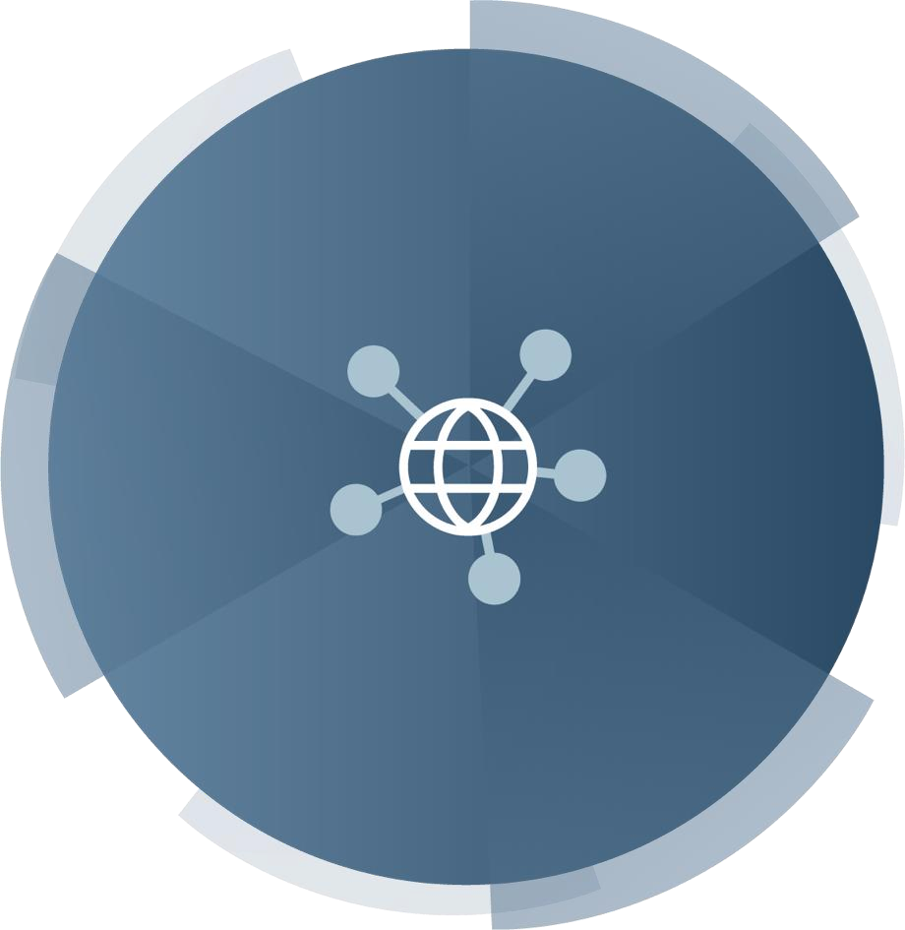
Data is exploding, and forcing changes in data storage and data management
Using the SAP HANA Service as a Datasource
Massive volumes of new data every day
4 PB of new data daily on Facebook
5 EB of new data every 2 days
Data is in the cloud and outside the firewall
2013 to 2020: 25T GB of new data mostly in the cloud (IDC)
By 2025, 95% of data will be real-
time IoT data (IDC)
Data processing in the cloud is growing
Data processed, stored, or delivered by public cloud will double to 26% by 2025 (IDC)
By 2021, 94% of workloads and compute instances processed in the cloud (Cisco)
Rapid growth in unstructured data
Growing by 62% per year (IDG)
By 2022, 93% of all data will be unstructured (IDG)
© 2019 SAP SE or an SAP affiliate company. All rights reserved. ǀ PUBLIC
IDG: International Data Group
IDC: International Data Corporation
2

Slide 3
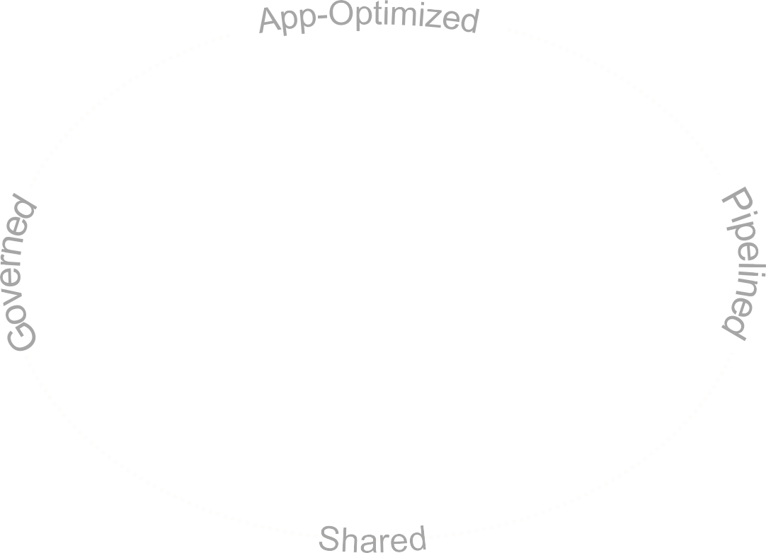

Using the SAP HANA Service as a Datasource
Data needs to be smarter and built for the Intelligent Enterprise
1
2
Data optimized for any application type
Relational
Spatial
Unstructured
Text
Big Data
Data available across the business for any analysis
Files
IoT
Streaming
Data across the enterprise

Slide 4
Using the SAP HANA Service as a Datasource
SAP HANA
SAP HANA Service
Tools
SAP HANA engines
SAP Cloud Platform cockpit
Spatial & Graph
Replication
Administration & Security
SAP Web IDE
Text Search & Analysis
Compression
Backup & Recovery
SAP HANA studio
Calculation Engine
SQLScript
Smart Data Access
SAP HANA cockpit
OLAP
OLTP
SAP HANA
Tenant Databases

Slide 5
Using the SAP HANA Service as a Datasource
All the benefits you expect from a cloud service…
✓
✓
✓
✓
✓
Available on-demand
Create new SAP HANA database instances as needed, in minutes, from cockpit or command line.
No hardware or OS to worry about
Concepts such as servers, nodes, and “scale out” disappear. No SAP HANA “system” or MDC. Just SAP HANA instances.
Change size when needed
Choose the size of your SAP HANA instance and change it at any time.
Zero/low admin
Forget about backups, we take care of it.
Subscription and/or pay-per-use
pricing
Hourly pricing option

Slide 6
Using the SAP HANA Service as a Datasource
SAP HANA service – Available in two editions
Enterprise Edition
SAP HANA service, enterprise edition:
Includes all capabilities of SAP HANA service, standard edition
Adds the advanced analytics options
Predictive
Text Analytics / Search
SAP HANA service, standard edition:
Includes core database services with in-memory capabilities
Spatial / Graph
Data Privacy
Smart Data Integration
Standard Edition
Series Data
Core DB Services

Slide 7

Using the SAP HANA Service as a Datasource
SAP HANA advanced analytics capabilities
Spatial
Gain deeper insights by combining business data with geographical data
Predictive
Make proactive and intelligent decisions that business can put
to immediate use
Graph
Go beyond traditional entities and build relationships into existing data on-the-fly
SAP HANA
Advanced Analytics
Streaming
Extract insight from real-time information streams and respond immediately to changing conditions
Text & Search
Embedded search that provides full-text search, navigation, and access to structured and unstructured information across multiple systems
Series Data
Capture and analyze a sequence of successive data points made over a
time interval

Slide 8
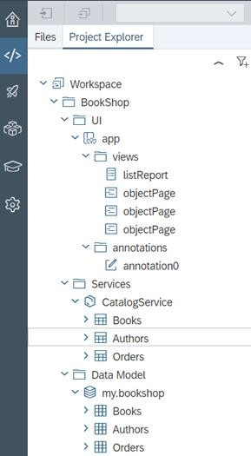
Developer tools
Using the SAP HANA Service as a Datasource
Application developers can use any number of tools including:
SAP Web IDE Full Stack service
this is an SAP Cloud Platform service that lets you build and deploy native SAP HANA applications directly into the SAP CP Cloud Foundry runtime
SAP Web IDE for SAP HANA
Download SAP HANA, express edition and build native SAP HANA applications locally, then deploy them to the cloud directly from SAP Web IDE for SAP HANA
SAP Enterprise Architecture Designer
Create and maintain a complete landscape architecture for your digital
transformation strategy
SAP HANA plugin for Microsoft Visual Studio

Slide 9

Using the SAP HANA Service as a Datasource
Hands-on/demo
How to create an SAP HANA service instance in the SAP Cloud Platform trial account

Slide 10

Using the SAP HANA Service as a Datasource
Further reading
i
Additional Material
SAP Cloud Platform Web site: SAP HANA service
SAP Cloud Platform documentation – SAP HANA
service

Slide 11

What you’ve learned in this unit
Using the SAP HANA Service as a Datasource
SAP HANA is more than just a database
How to use the SAP HANA service in SAP Cloud Platform
How to create a database in your SAP Cloud Platform
trial account

Slide 12
Thank you.
Contact information:
open@sap.com

Slide 13





Follow all of SAP
www.sap.com/contactsap
© 2019 SAP SE or an SAP affiliate company. All rights reserved.
No part of this publication may be reproduced or transmitted in any form or for any purpose without the express permission of SAP SE or an SAP affiliate company.
The information contained herein may be changed without prior notice. Some software products marketed by SAP SE and its distributors contain proprietary software components of other software vendors. National product specifications may vary.
These materials are provided by SAP SE or an SAP affiliate company for informational purposes only, without representation or warranty of any kind, and SAP or its affiliated companies shall not be liable for errors or omissions with respect to the materials. The only warranties for SAP or SAP affiliate company products and services are those that are set forth in the express warranty statements accompanying such products and services, if any. Nothing herein should be construed as constituting an additional warranty.
In particular, SAP SE or its affiliated companies have no obligation to pursue any course of business outlined in this document or any related presentation, or to develop or release any functionality mentioned therein. This document, or any related presentation, and SAP SE’s or its affiliated companies’ strategy and possible future developments, products, and/or platforms, directions, and functionality are all subject to change and may be changed by SAP SE or its affiliated companies at any time for any reason without notice. The information in this document is not a commitment, promise, or legal obligation to deliver any material, code, or functionality. All forward-looking statements are subject to various risks and uncertainties that could cause actual results to differ materially from expectations. Readers are cautioned not to place undue reliance on these forward-looking statements, and they should not be relied upon in making purchasing decisions.
SAP and other SAP products and services mentioned herein as well as their respective logos are trademarks or registered trademarks of SAP SE (or an SAP affiliate company) in Germany and other countries. All other product and service names mentioned are the trademarks of their respective companies.
See www.sap.com/corporate-en/legal/copyright/index.epx for additional trademark information and notices.

Slide 14
Week 2: Your First Cloud Application
Unit 2: Introducing SAP Web IDE

Slide 15
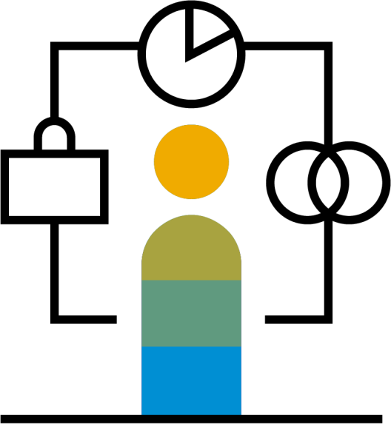
SAP Web IDE – Product description
Introducing SAP Web IDE
SAP Web IDE is a powerful, extensible, web-based integrated development tool that simplifies end-to-end development of business applications
Efficiently develop business applications for Intelligent Enterprise scenarios such as SAP S/4HANA extensions, SAP Fiori, mobile, and Internet of Things (IoT) apps

Slide 16

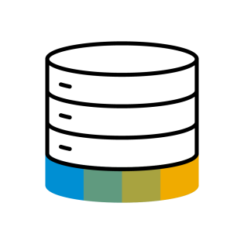

Introducing SAP Web IDE
Delivery options
SAP Cloud Platform
SAP HANA on-premise
SAP Web IDE Full-Stack
SAP Web IDE for SAP HANA
Develop and extend SAP business applications for SAP Cloud Platform and SAP core
Use case
Develop business applications for SAP HANA
SAPUI5 / SAP Fiori Java, Node.js SAP HANA*
Use OData Services
Deploy to or
SAPUI5 / SAP Fiori* Node.js, XSJS, Java SAP HANA
Use OData Services
Deploy to
Technology
SAP core, SAP S/4HANA, SucessFactors …
XS advanced (local service)
SAP CP (Neo, CF)
ABAP
XS advanced
Zero installation, low administration
Ubiquitous availability
Bi-weekly updates
Included with various SAP Cloud Platform packages
Released with SAP HANA SPSs
Included in SAP HANA license
Available with SAP HANA, express edition
Delivery
* Partial support

Slide 17



SAP Web IDE – Value proposition
Introducing SAP Web IDE
Simple
Available anytime, anywhere, no need for complex infrastructure, reducing cost, complexity, and effort
Integrated
Easily leverage SAP Cloud Platform services to build smarter, more intelligent applications that solve your business problems
Productive
Innovate on SAP Cloud Platform quickly and easily creating or extending business apps, allowing developers to focus on their business domain

Slide 18





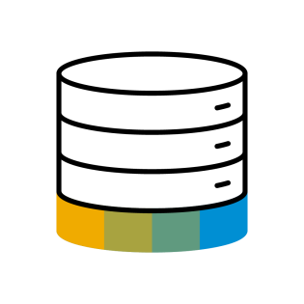
Introducing SAP Web IDE
SAP Web IDE – Key use cases
Refresh user experience
Extend the digital core
Model and deploy SAP BPM workflows
Innovate IoT with
SAP Leonardo
Mobilize your
business
Develop SAP HANA
native applications

Slide 19












The big picture
Introducing SAP Web IDE
Applications
SAP Fiori
SAP S/4HANA Extensions SaaS
SAP HANA Analytics SAP Leonardo(IoT) Mobile
Features
SAP Leonardo (IoT)
External services
Workflow
SAP Gateway
(OData services)
Hybrid Application Toolkit
SDK
SAP Web IDE
Data Sources
SAP HANA
(OData services)
SAP API Business Hub
REST services
SAP Cloud Platform (Neo, CF)
SAP Mobile Platform
ABAP

Slide 20

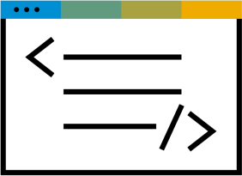



Development process overview
Introducing SAP Web IDE
Design
Develop
Build
Test
Deploy

Slide 21


Introducing SAP Web IDE
Design
Design
Develop
Build
Test
Deploy
Jump-start your designs with one of many prototype
examples from the gallery
Collaboratively develop prototypes with your project team and engage end users for feedback
Easily import the Build prototype to SAP Web IDE and use it as a starting point for your SAP Fiori app
SAP Build

Slide 22


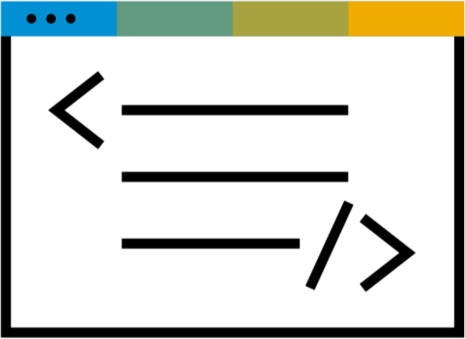




Introducing SAP Web IDE
Develop
Design
Develop
Build
Test
Deploy
Templates and wizards
Visual/code editors
Instant preview with real/mock data Debugging
SAP and open source technologies Source control management

Slide 23




Introducing SAP Web IDE
Build
Design
Develop
Build
Test
Deploy
Building UI Applications
Use Grunt open source task
runner to build your UI app
Building Business Applications
Build a deployment package from your UI, database, and business-logic modules sharing the same lifecycle

Slide 24

Introducing SAP Web IDE
Test
Design
Develop
Build
Test
Deploy
Leverage integrated testing capabilities to validate your application’s functionality and compatibility
Test Authoring
Wizard-based and code-based assistance for developing unit tests (UI, Java, Node.js) and integration tests (UI)
Test Execution
SAP Web IDE empowers developers to test and evaluate their app’s functionality during development

Slide 25

Introducing SAP Web IDE
Deploy
Design
Develop
Build
Test
Deploy
Multiple options are available for a developer to deploy a new application or update an existing application on the target system and register it to the SAP Fiori launchpad on SAP Cloud Platform
SAP Cloud Platform
Neo, Cloud Foundry
SAPUI5 ABAP repository
SAP Mobile Platform
(for mobile applications)

Slide 26
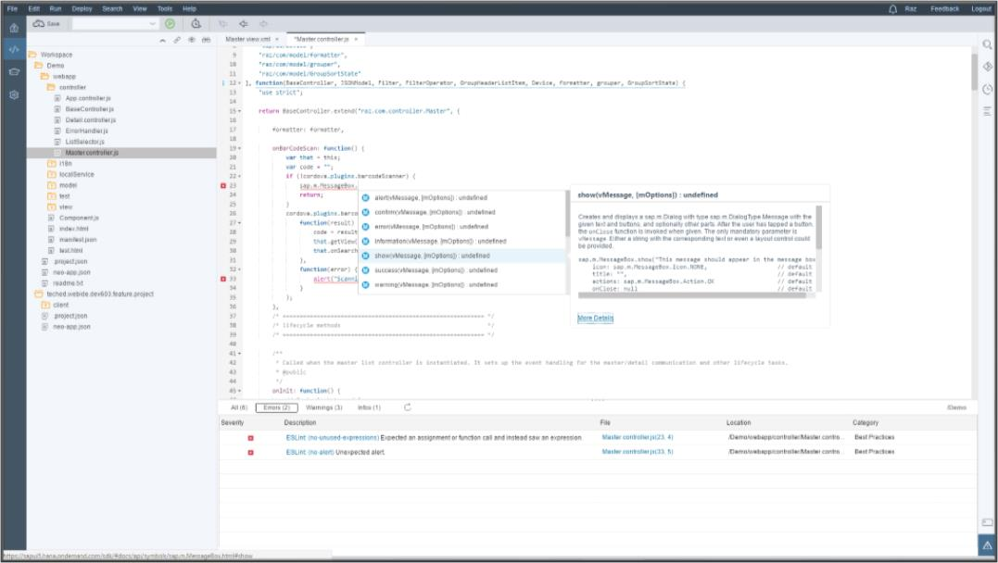
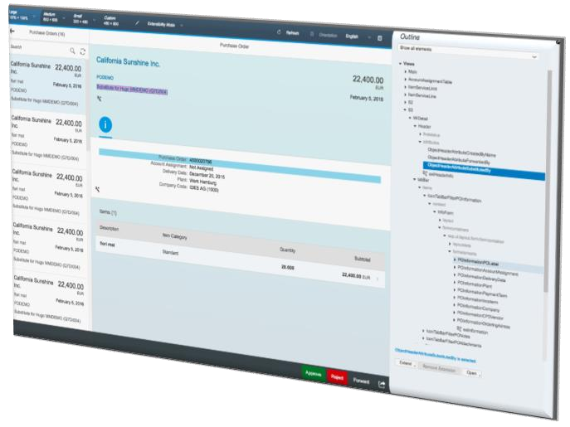
Introducing SAP Web IDE
Additional features
Sample applications, templates and wizards for creating SAPUI5 applications, SAP Fiori applications, business applications, SAP HANA database modeling, Java/Node.js modules and full-stack applications
Creating and testing applications with specific SAPUI5 version
Layout Editor (WYSIWYG) for SAPUI5
User-friendly graphical extension mechanisms for SAP Fiori applications
SAP HANA database graphical editors
Source code editor with code completion, validation, and formatting for JavaScript, SAPUI5, Java, Node.js, and Core Data Services (CDS)
Built-in application preview
Mock data support for back-end-decoupled development and testing
Integration with various data sources
Integrated Git source control
SAP Web IDE extension possibilities via custom extensions

Slide 27
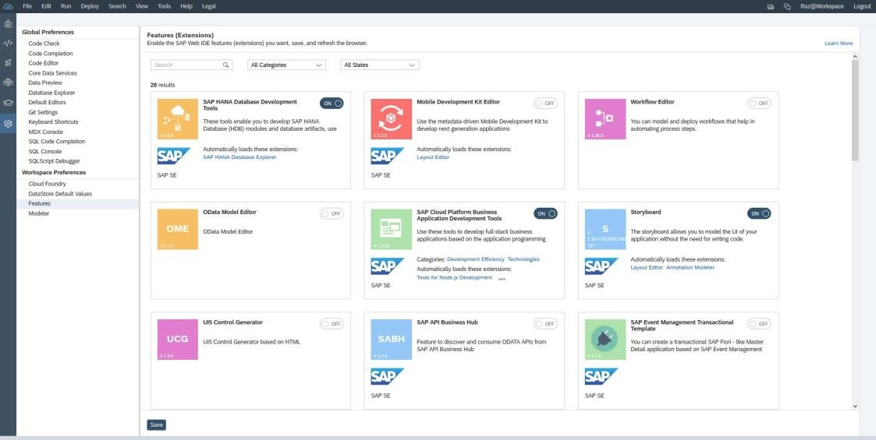
SAP Web IDE features
Introducing SAP Web IDE
SAP Web IDE is a modular and extensible framework enabling anyone to extend SAP Web IDE with new capabilities and for others to use
Extensions (features) are constructed from one or more plugins where each plugin encapsulates different capabilities, such as development scenarios, templates, tools, and more
You can enable extensions in the Preferences
perspective > Workspace Preferences
Perspectives, views, menu items, etc. are dynamic according to the enabled extensions
For example, enabling “Tools for Java development” adds the ability to create a Java module

Slide 28



SAP Cloud Platform – Get started today!
Introducing SAP Web IDE
Learn More!
Try for Free!
Find it on SAP Store!
Reach Out!
developer.sap.com
cloudplatform.sap.com
sapstore.com
Contact your SAP Account Executive

Slide 29

Introducing SAP Web IDE
Further reading
i
Additional Material
Official Documentation
SAP Web IDE Homepage
Additional Information on SAP Cloud Platform Web Site Technical Questions

Slide 30
What you’ve learned in this unit
Introducing SAP Web IDE
Key capabilities of SAP Web IDE to support full-stack application development with regard to data model, business logic and user interface
Delivery options in cloud and on-premise
Development process with SAP Web IDE – Design, Develop, Build, Test, and Deploy

Slide 31
Thank you.
Contact information:
open@sap.com

Slide 32
Follow all of SAP
www.sap.com/contactsap
© 2019 SAP SE or an SAP affiliate company. All rights reserved.
No part of this publication may be reproduced or transmitted in any form or for any purpose without the express permission of SAP SE or an SAP affiliate company.
The information contained herein may be changed without prior notice. Some software products marketed by SAP SE and its distributors contain proprietary software components of other software vendors. National product specifications may vary.
These materials are provided by SAP SE or an SAP affiliate company for informational purposes only, without representation or warranty of any kind, and SAP or its affiliated companies shall not be liable for errors or omissions with respect to the materials. The only warranties for SAP or SAP affiliate company products and services are those that are set forth in the express warranty statements accompanying such products and services, if any. Nothing herein should be construed as constituting an additional warranty.
In particular, SAP SE or its affiliated companies have no obligation to pursue any course of business outlined in this document or any related presentation, or to develop or release any functionality mentioned therein. This document, or any related presentation, and SAP SE’s or its affiliated companies’ strategy and possible future developments, products, and/or platforms, directions, and functionality are all subject to change and may be changed by SAP SE or its affiliated companies at any time for any reason without notice. The information in this document is not a commitment, promise, or legal obligation to deliver any material, code, or functionality. All forward-looking statements are subject to various risks and uncertainties that could cause actual results to differ materially from expectations. Readers are cautioned not to place undue reliance on these forward-looking statements, and they should not be relied upon in making purchasing decisions.
SAP and other SAP products and services mentioned herein as well as their respective logos are trademarks or registered trademarks of SAP SE (or an SAP affiliate company) in Germany and other countries. All other product and service names mentioned are the trademarks of their respective companies.
See www.sap.com/corporate-en/legal/copyright/index.epx for additional trademark information and notices.

Slide 33
Week 2: Your First Cloud Application
Unit 3: Building a Small UI5 Application

Slide 34
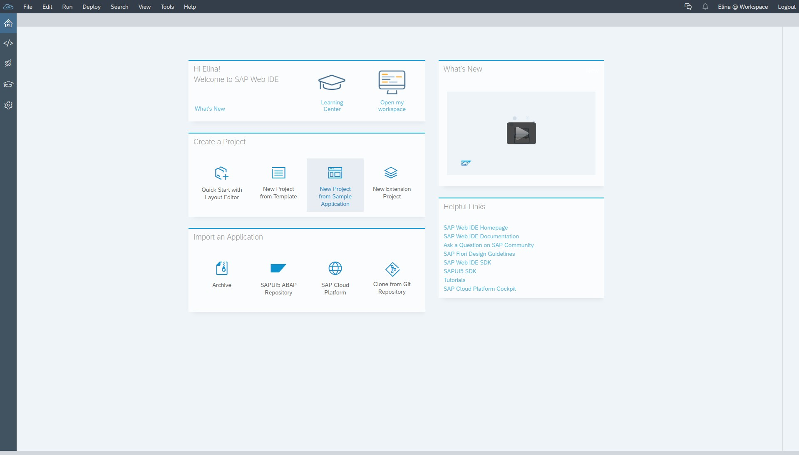
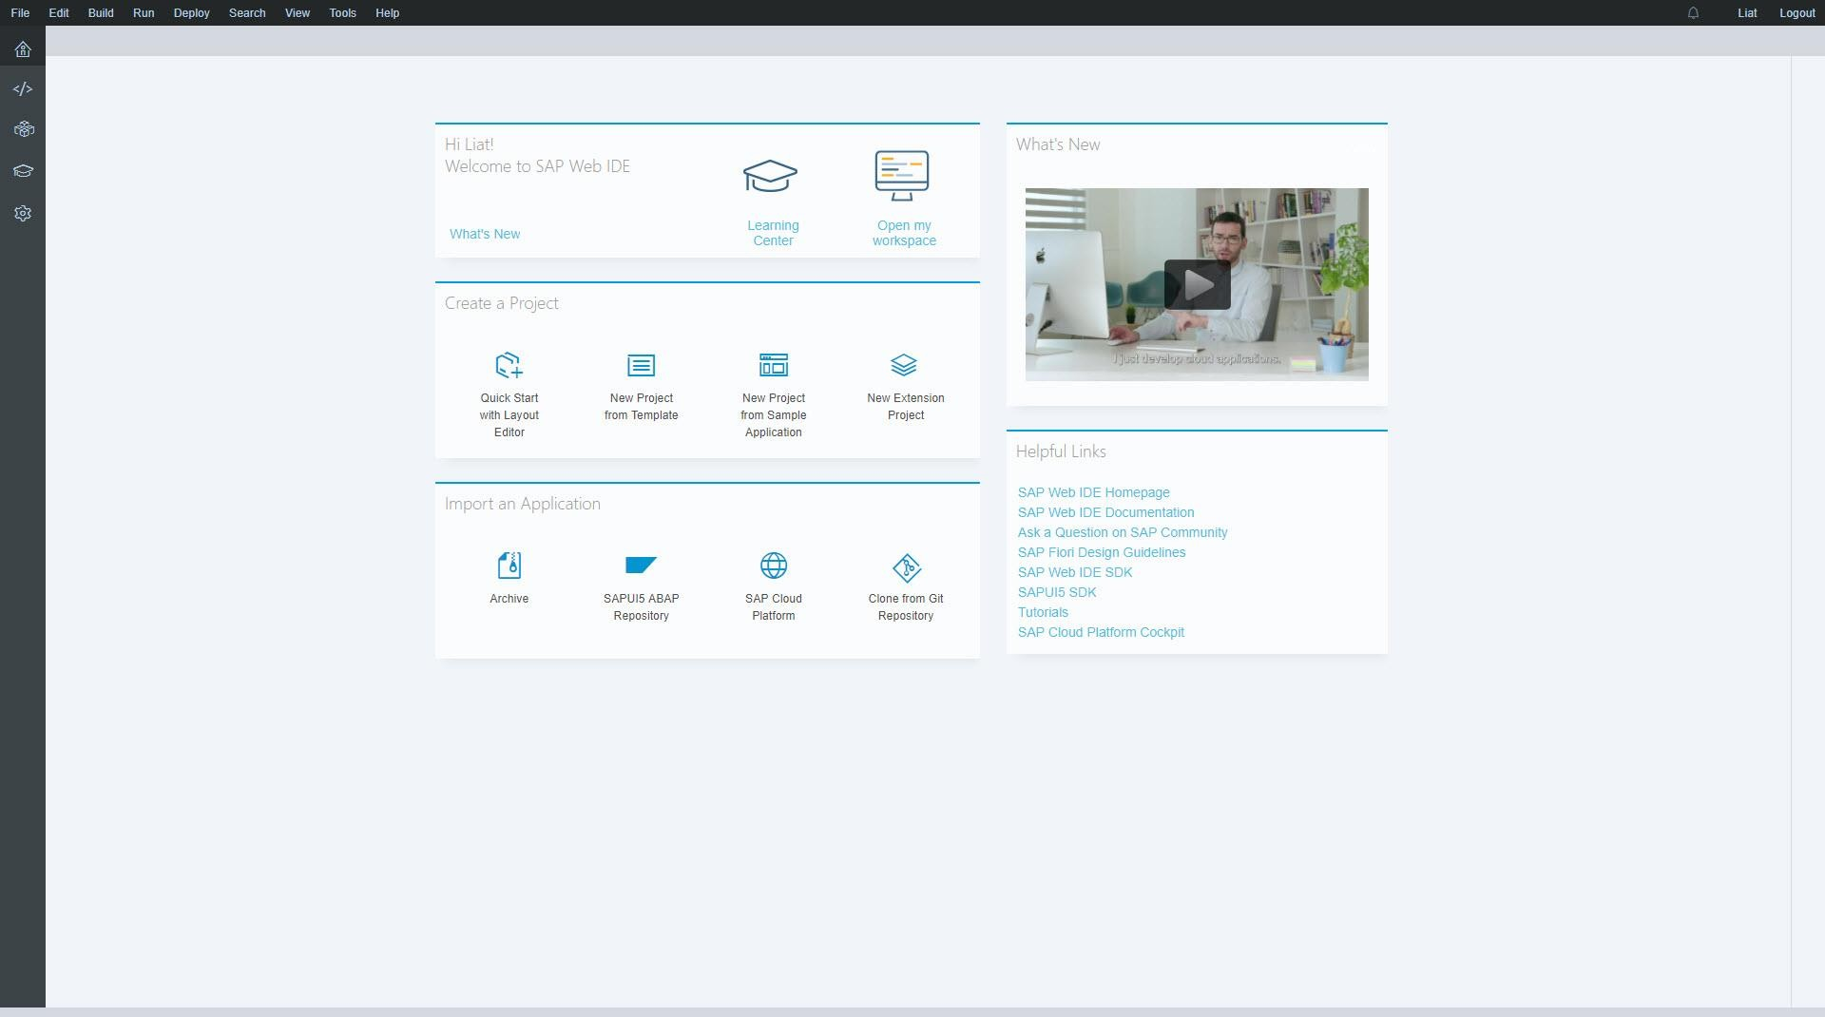
Building a Small UI5 Application
Welcome screen
Perspectives:
Home (Welcome)
Development
Storyboard
Learning Center
Preferences
Notifications
User Name
Workspace
Feedback
Logout
Current version
Notification every time an update is pushed
Users can read
about new features
Link to external resources and tools
Quick and easy access to the most common creation actions

Slide 35
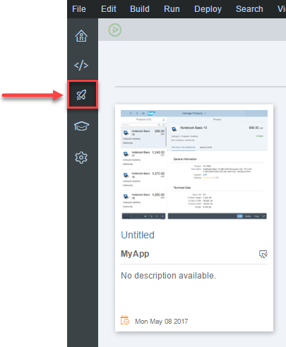
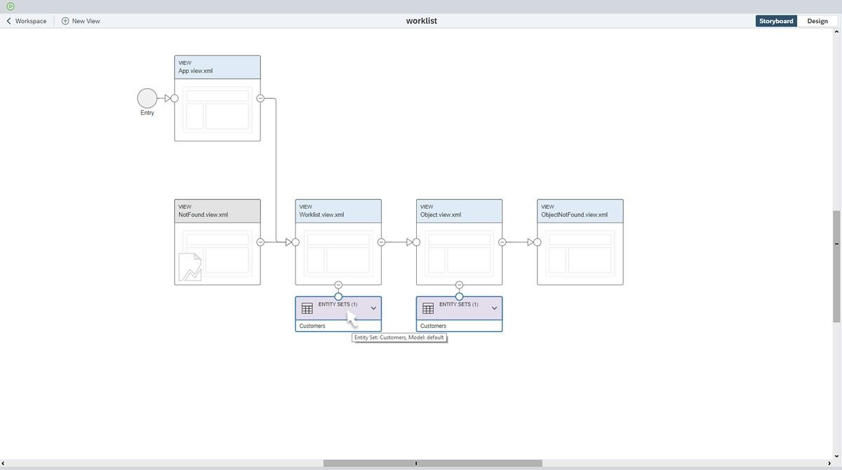
Building a Small UI5 Application
Storyboard: SAP Fiori and UI development
The storyboard provides a visual representation of the application's UI including its pages (views), navigations, services, and entities that it uses.
Open the Storyboard perspective from the left
sidebar
Select the desired project
The Storyboard tab opens, showing all the views with the navigations and respective entity sets
When you hover your mouse over the entity set, the model origin appears in a tooltip
You can create new views and navigation between views in the Storyboard perspective

Slide 36
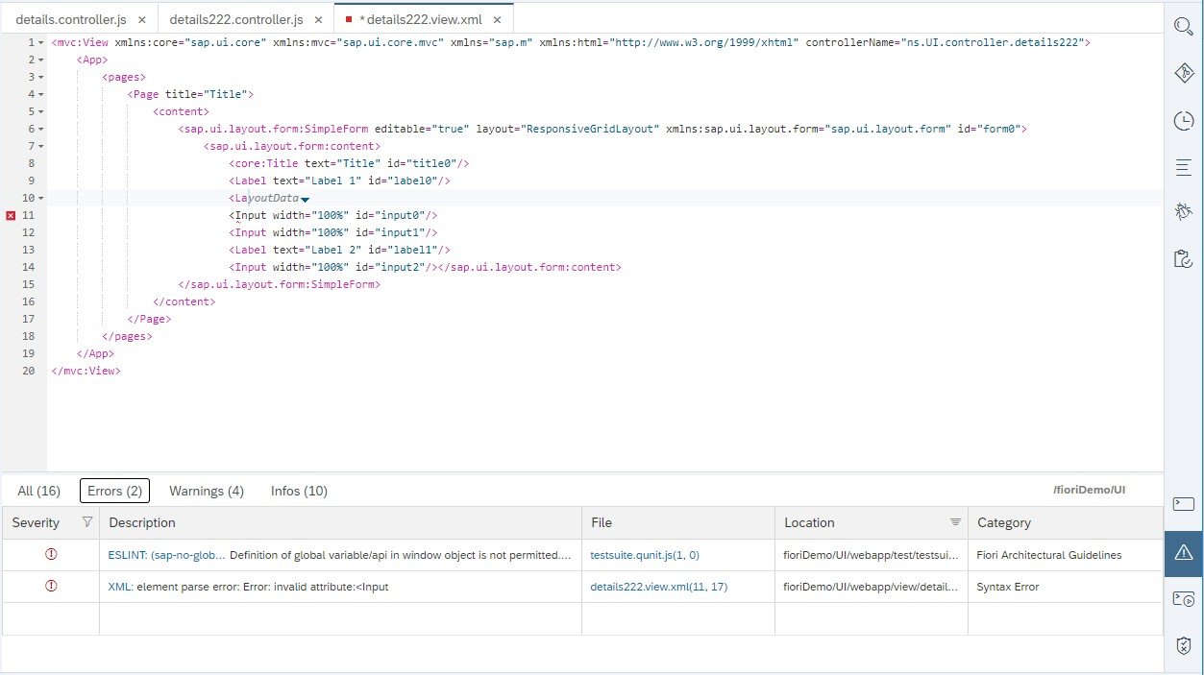
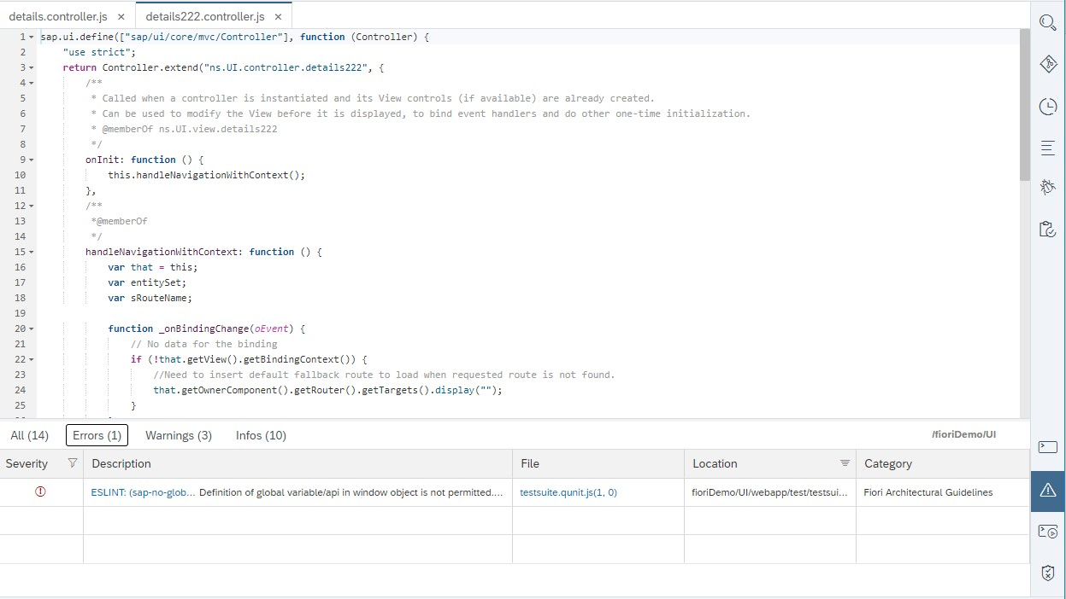
Building a Small UI5 Application
SAPUI5 development – Code editors
Code editor for JS, XML, JSON, and CSS
Integration with static code quality tools (ESLint)
JSON validator – syntax, neo-app and manifest
Semantic checks for SAPUI5 XML
Beautifiers for JS, XML, JSON, and CSS
API reference pane for SAPUI5 control documentation
Outline pane for the JS main entities and the flow of the application
Cross-file navigation for JS
Compare editor and manifest editor
SAPUI5 code-completion for XML, JS
Editor completes words, code fragments, or entire SAPUI5 objects
Cross-file code completion
Snippet-based XML and JS auto-completion
Easily set a different SAPUI5 version
Auto-hint – code completion while typing

Slide 37
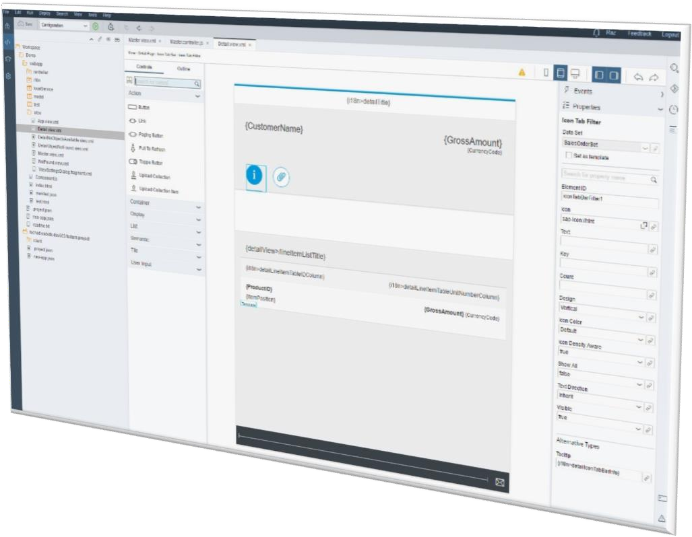
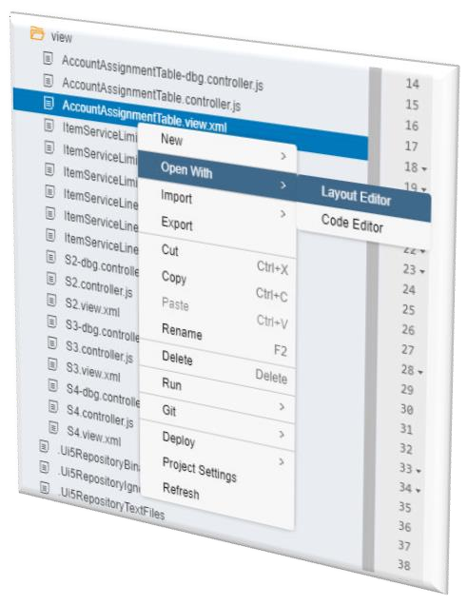
Layout editor (WYSIWYG)
Building a Small UI5 Application
Design your view graphically in the layout editor
and display the content of the XML view
Right-click an XML file and open it with the layout editor
Design the view in the graphical display (canvas)
Drag and drop the SAPUI5 controls from the palette to the canvas
Configure the properties and events of the controls
Bind the data fields to the OData service entity sets

Slide 38
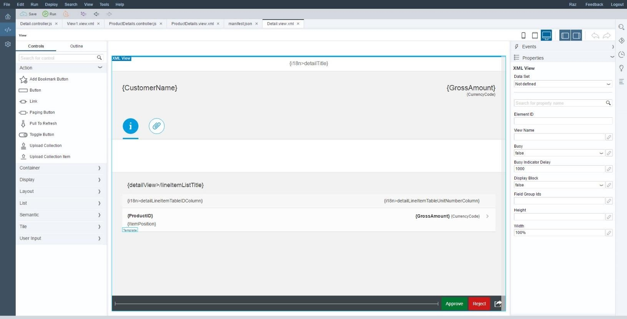
Building a Small UI5 Application
Layout editor (WYSIWYG)
Device Form Factor
Smartphone/Tablet/Desktop
Panes Hide/Show
Canvas
Content of the XML view
Graphical display
Undo/Redo
Properties, Events and Data Pane
Shows properties and data of selected control
Palette/Outline
SAPUI5 controls
Drag & drop controls to the canvas
Add/Remove
controls from Outline
Focus on control from Outline
Entity sets and properties of OData service
OData binding

Slide 39
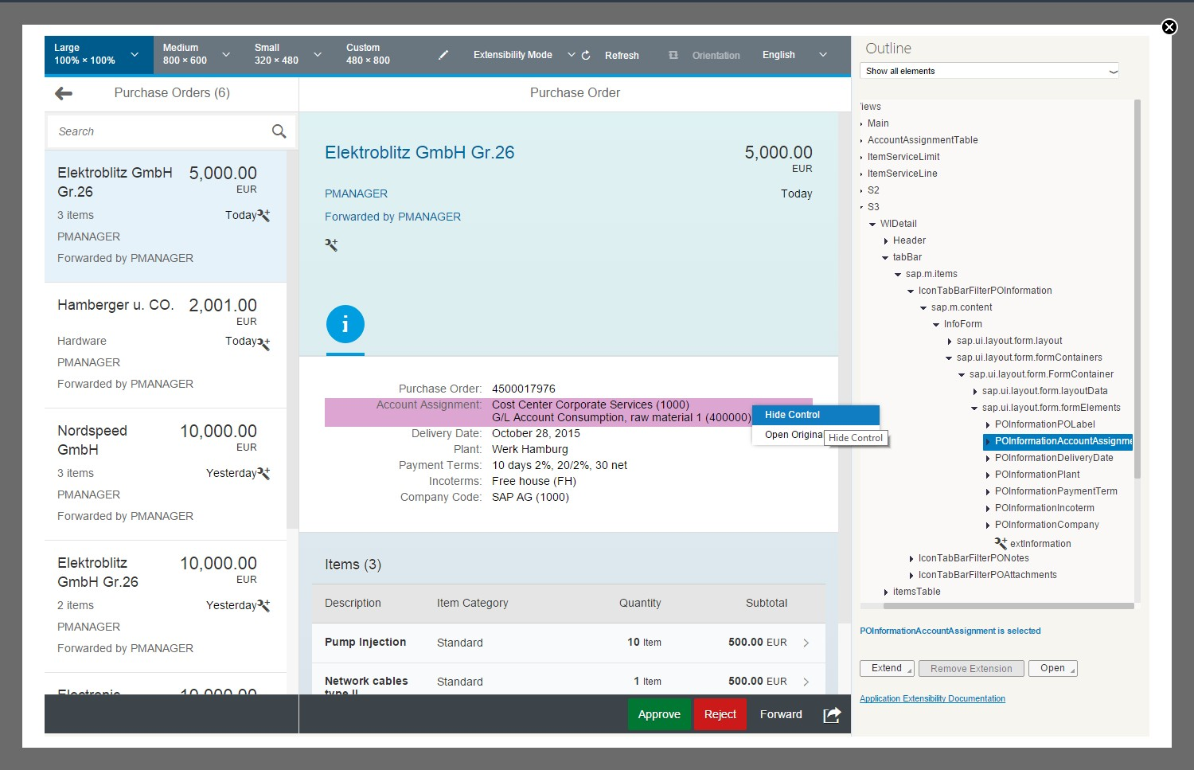
Building a Small UI5 Application
SAP Fiori extensions – Extensibility pane
While running the app, you can select an element either in the outline or directly in the app when in extensibility mode
Appropriate extension options can be selected
Application can get data online from back end or using mock data
Preview/Extensibility Mode
Show all application elements, or filter by extensible or extended elements or extension points
Outline:
Shows the UI elements available in the application, as well as extension points and UI controller hooks

Slide 40
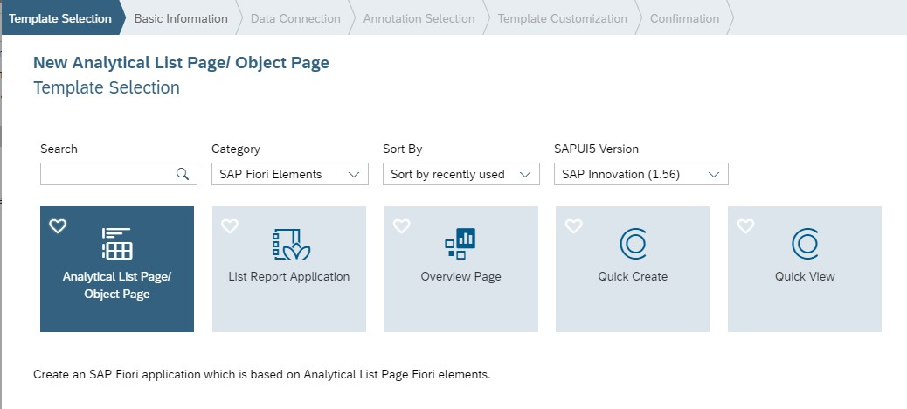
Building a Small UI5 Application
SAP Fiori elements
Use SAP Fiori elements to create SAP Fiori applications based on OData services and annotations
Create an SAP Fiori application based on one
of the following templates:
Application List Page
List Report Application
Overview Page
Quick Create
Quick View
No UI coding; development is focused on the business logic
The resulting application uses predefined views and controllers that are provided with the template
Provides UI consistency across all similar applications

Slide 41
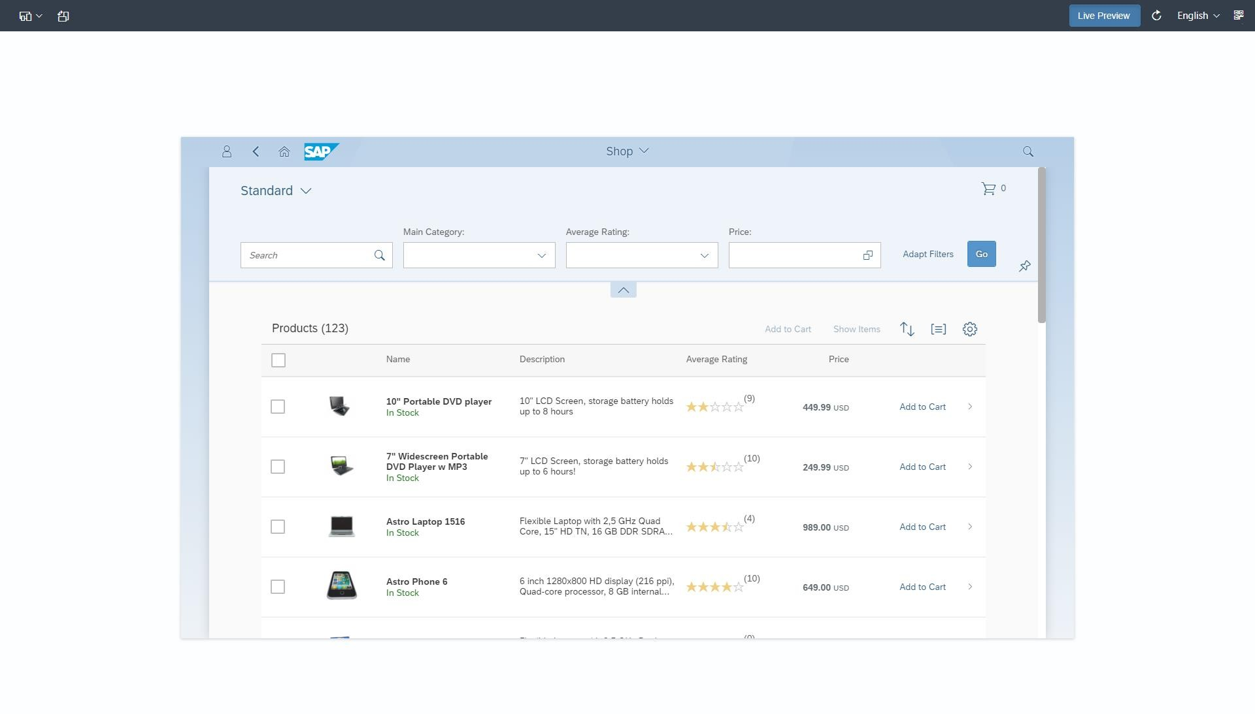
Building a Small UI5 Application
Testing in SAP Web IDE: application preview in the browser
Frame:
Option to run with frame in “Run Configurations”
QR code generation:
A QR code is generated for the URL by clicking the rectangle
Choice of resolution:
Desktop (large)
Mobile devices, e.g. iPad (medium), iPhone (small), Android, etc.
Define a custom size The application is
responsive – will adapt its appearance to the screen size
Multiple screen sizes are predefined
Language:
If the application supports multiple languages (i18n properties), then the language text can be changed on-the-fly
Refresh:
The application can be reloaded without needing to rerun it from the development environment
Orientation:
The orientation of the screen can be toggled between landscape and portrait view
Live Preview:
Refreshes the preview automatically on change of resource

Slide 42

Building a Small UI5 Application
Hands-on/demo steps
Create a new workspace
Create a new MTA project
Create a new HTML5 module with an empty view
Connect to a data system
Open the Storyboard and see the application (views, navigations, collections)
Open the view in layout editor and create a list
Create a second view in the Storyboard
Create navigation between the views
Open the second view in the layout editor and add some content
Edit the views with the code editor
Test the application

Slide 43
Building a Small UI5 Application
Further reading
i
Additional Material
SAPUI5
SAPUI5 Developer Center – Demo Kit (interactive doc on SAPUI5/OpenUI5): https://sapui5.hana.ondemand.com/sdk/
OpenUI5: http://sap.github.io/openui5/
SAP Web IDE
SAP Web IDE Home Page: https://www.sap.com/developer/topics/sap-webide.html
Technical Questions – Use SAP Community: https://answers.sap.com/tags/73554900100700001351
SAP Cloud Platform: https://cloudplatform.sap.com/index.html
SAP Cloud Platform Trial:
https://account.hanatrial.ondemand.com/
SAP Help Portal for SAP Web IDE: https://help.sap.com/viewer/825270ffffe74d9f988a0f0066ad59f0/CF/ en-US/0221845d73ad403ab2852142f3179177.html

Slide 44
Building a Small UI5 Application
What you’ve learned in this unit
Overview of how to use SAP Web IDE
How to create SAPUI5 applications
SAP Web IDE’s Storyboard and layout editor
How to test SAPUI5 applications
Developing your first SAPUI5 cloud app

Slide 45
Thank you.
Contact information:
open@sap.com

Slide 46
Follow all of SAP
www.sap.com/contactsap
© 2019 SAP SE or an SAP affiliate company. All rights reserved.
No part of this publication may be reproduced or transmitted in any form or for any purpose without the express permission of SAP SE or an SAP affiliate company.
The information contained herein may be changed without prior notice. Some software products marketed by SAP SE and its distributors contain proprietary software components of other software vendors. National product specifications may vary.
These materials are provided by SAP SE or an SAP affiliate company for informational purposes only, without representation or warranty of any kind, and SAP or its affiliated companies shall not be liable for errors or omissions with respect to the materials. The only warranties for SAP or SAP affiliate company products and services are those that are set forth in the express warranty statements accompanying such products and services, if any. Nothing herein should be construed as constituting an additional warranty.
In particular, SAP SE or its affiliated companies have no obligation to pursue any course of business outlined in this document or any related presentation, or to develop or release any functionality mentioned therein. This document, or any related presentation, and SAP SE’s or its affiliated companies’ strategy and possible future developments, products, and/or platforms, directions, and functionality are all subject to change and may be changed by SAP SE or its affiliated companies at any time for any reason without notice. The information in this document is not a commitment, promise, or legal obligation to deliver any material, code, or functionality. All forward-looking statements are subject to various risks and uncertainties that could cause actual results to differ materially from expectations. Readers are cautioned not to place undue reliance on these forward-looking statements, and they should not be relied upon in making purchasing decisions.
SAP and other SAP products and services mentioned herein as well as their respective logos are trademarks or registered trademarks of SAP SE (or an SAP affiliate company) in Germany and other countries. All other product and service names mentioned are the trademarks of their respective companies.
See www.sap.com/corporate-en/legal/copyright/index.epx for additional trademark information and notices.

Slide 47

Week 2: Your First Cloud Application
Unit 4: Deploying the App to Cloud Foundry

Slide 48

Deploying the App to Cloud Foundry
Hands-on/demo steps
Configure the Cloud Foundry space in
SAP Web IDE
Deploy the application to the Cloud Foundry space
Build the application
2

Slide 49

UI application Grunt build
Deploying the App to Cloud Foundry
Grunt is an open-source task runner based on the Node.js runtime environment. Grunt allows you to automate tasks that front-end developers perform on a regular basis, such as minifying JavaScript and CSS files, unit testing, linting files to check for errors, compiling CSS preprocessor files such as LESS or SASS.
SAP Web IDE includes a Grunt task runner
Configure by:
Specifying dependencies in the package.json file
Defining tasks in the Gruntfile.js file
You can use your own Grunt plugin or other publicly available plugins
3

Slide 50
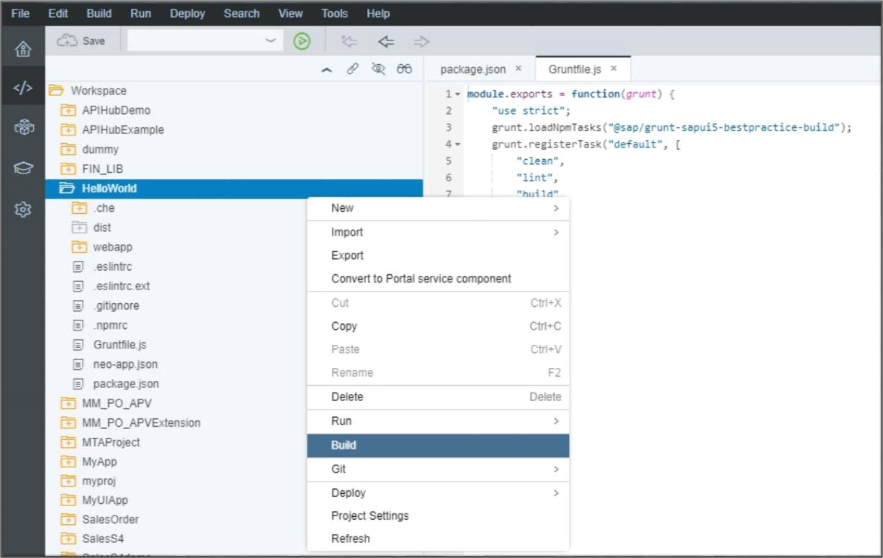
UI application Grunt build
Deploying the App to Cloud Foundry
To run the Grunt build, right-click your project’s root folder and select Build from the menu or context menu
The build does the following:
Runs the tasks specified in the Gruntfile.js file
Creates a new folder in your project named dist
containing the build artifacts
4

Slide 51
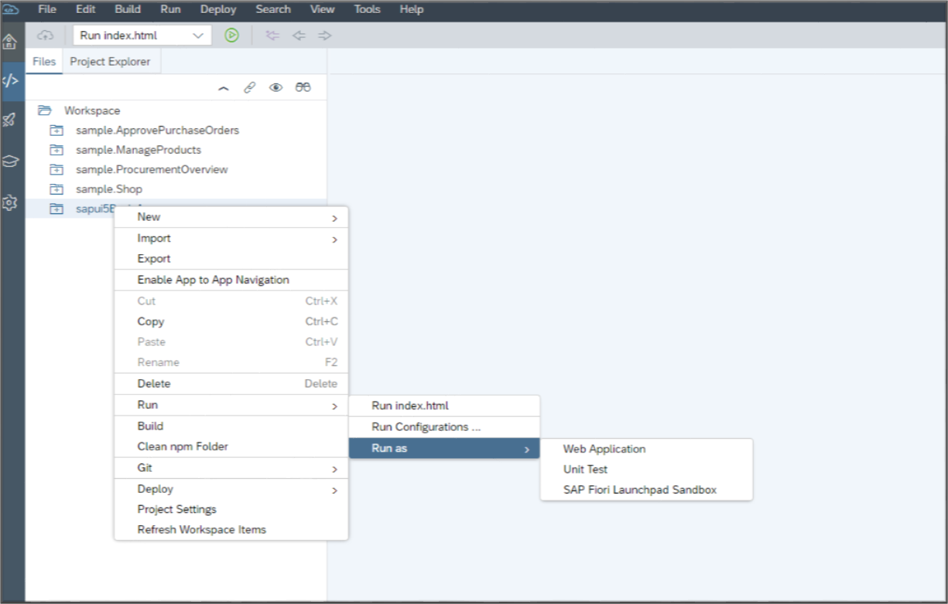
Testing in SAP Web IDE – Running a UI application
Deploying the App to Cloud Foundry
Run the application to test functionality, design,
and performance
Run as
Web Application: Previews the application in a
browser
Unit Test: Runs the application as a unit test
SAP Fiori Component on Sandbox: Runs the application in the SAP Fiori launchpad environment
Defines how the application runs, including the
SAPUI5 runtime version
5

Slide 52
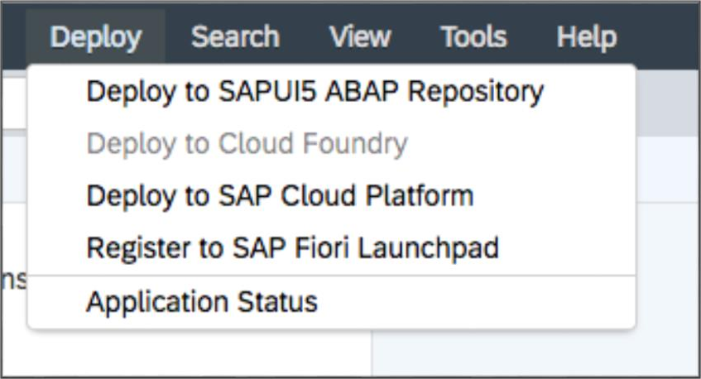
Application deployment
Deploying the App to Cloud Foundry
Multiple options are available for a developer to deploy a new application or update an existing application on the target system
SAP Cloud Platform, Cloud Foundry environment
SAP Cloud Platform, Neo environment
SAPUI5 ABAP repository
SAP Cloud Platform Mobile Services
Additional SAP Web IDE extensions may implement deployment to additional platforms
6

Slide 53
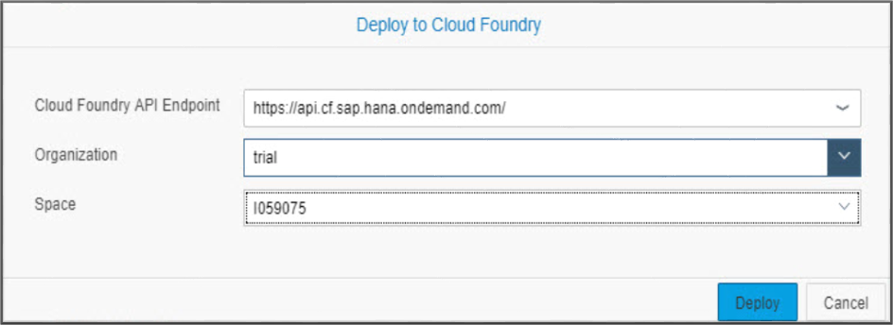
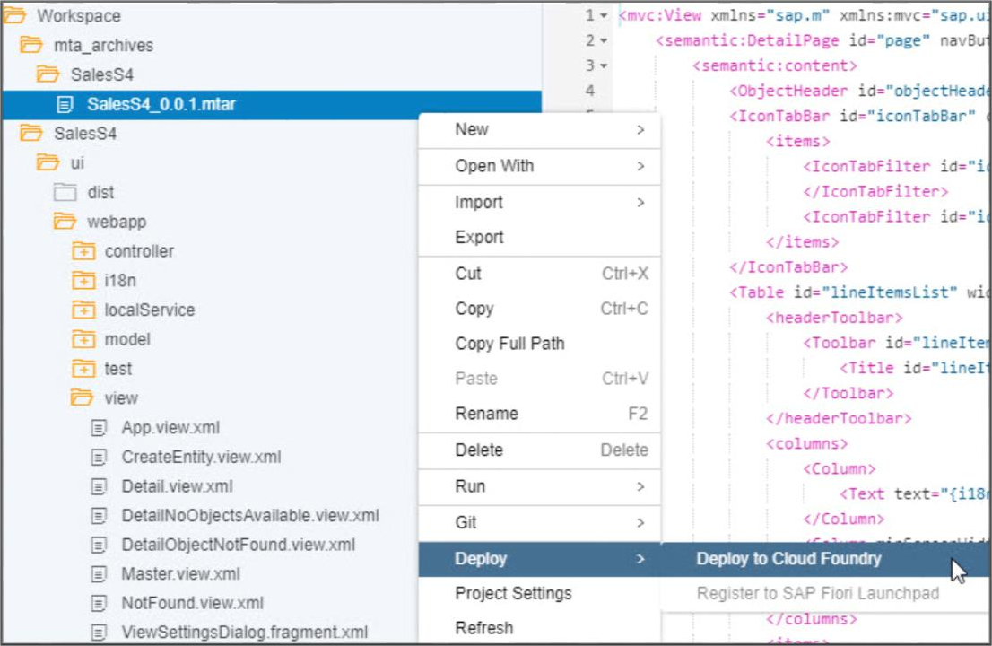
Deploy to SAP Cloud Platform – Cloud Foundry
Deploying the App to Cloud Foundry
You need to build your project before deployment
The build process generates an .mtar file that
packages your modules/application
To deploy your application:
Specify the .mtar file you want to deploy under
the mta_archives folder.
Select the Cloud Foundry API endpoint,
organization, and space.
Applications packaged in the .mtar file are deployed to the CF space defined for your project.
7

Slide 54
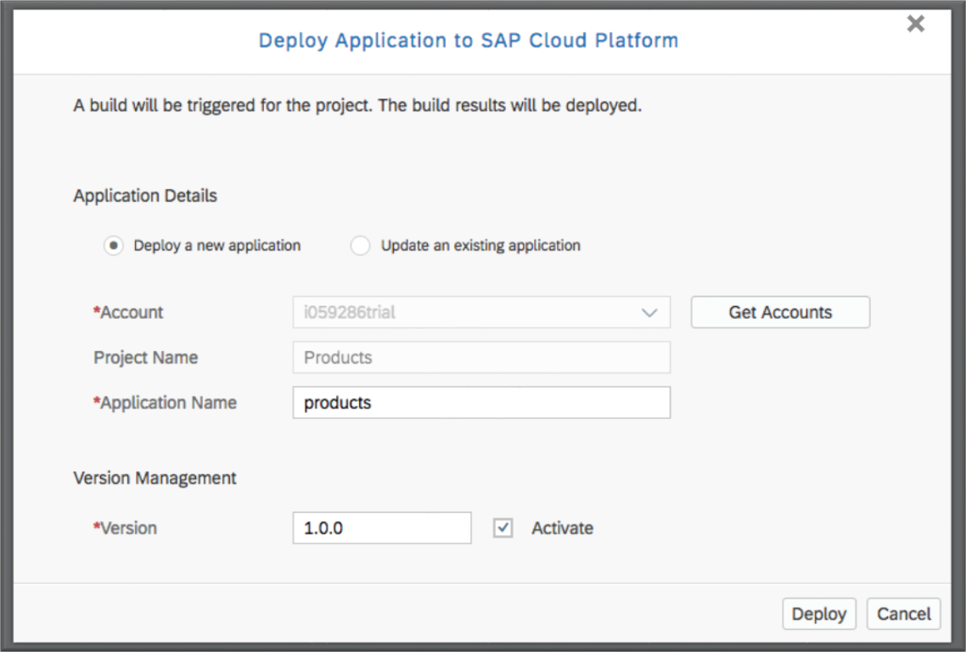
Deploy to SAP Cloud Platform – Neo
Deploying the App to Cloud Foundry
To deploy an application to SAP Cloud Platform – Neo:
Choose whether to deploy as a new application or as an update to an existing application
Select the account to deploy to
Set the version number
You may define whether the version should be
automatically activated or not
Once the application is successfully deployed, you may:
Check the application status: State, Versions, Active
Version
Register the application to SAP Fiori launchpad
8

Slide 55
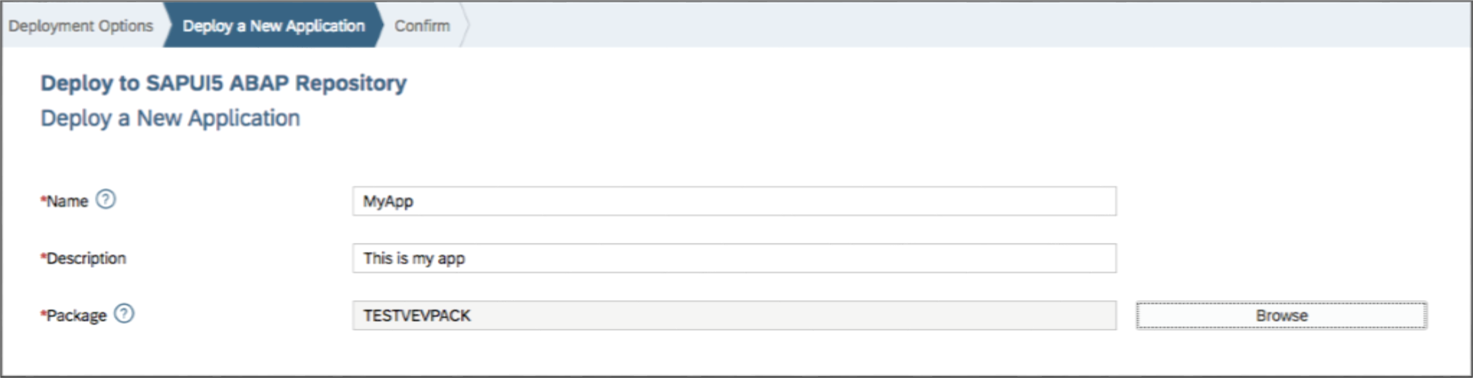
Deploying the App to Cloud Foundry
Deploy to SAPUI5 ABAP repository
To deploy an application to the SAPUI5 ABAP repository:
Choose the system you want to deploy to
Deploy your application as a new application or update an existing application
If required according to your development status and the chosen package, select a transport request
or create a new one (the request ID will be generated automatically)
9

Slide 56
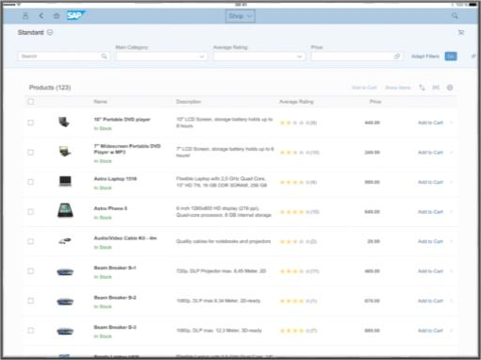
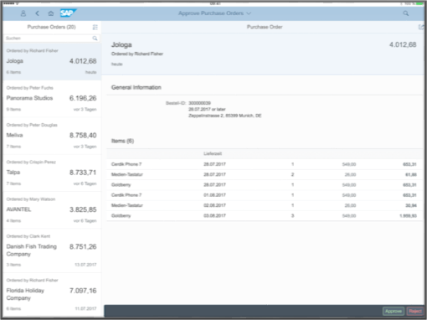
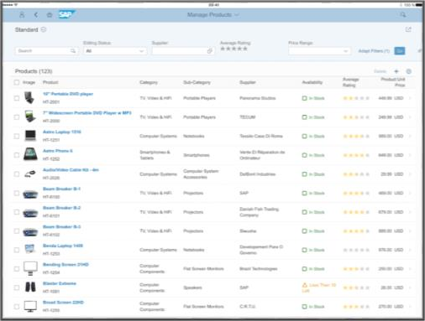
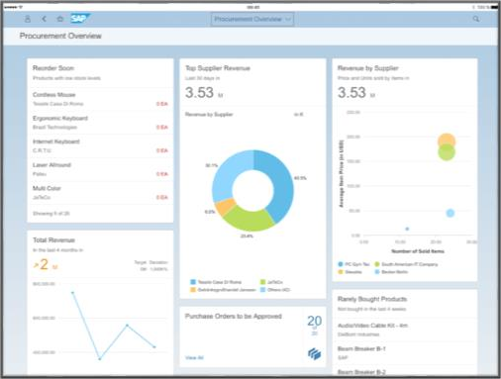
Deploying the App to Cloud Foundry
SAP Fiori sample applications
Complete and working SAP Fiori apps
Provide exemplary code, comprehensive comments, best-practices for SAP Fiori applications
Mock-server support for testing without a back-end system
Shop browse products and add them to a shopping basket | Approve Purchase Orders review and approve/reject purchase orders | Manage Products maintain the product master of the shop | Procurement Overview An overview of the revenue, best sellers, new sales orders, and more
Transactional application Freestyle application Worklist pattern | Transactional application Freestyle application Split view (Master-Detail) pattern | Transactional application with edit capabilities SAP Fiori elements application Worklist pattern | SAP Fiori elements application Overview Page pattern
10

Slide 57
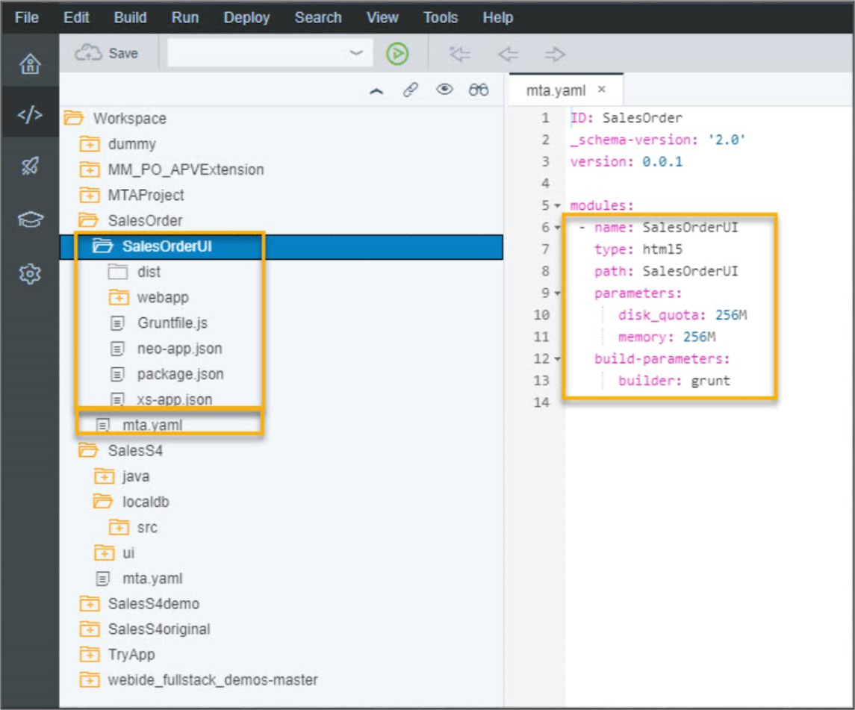
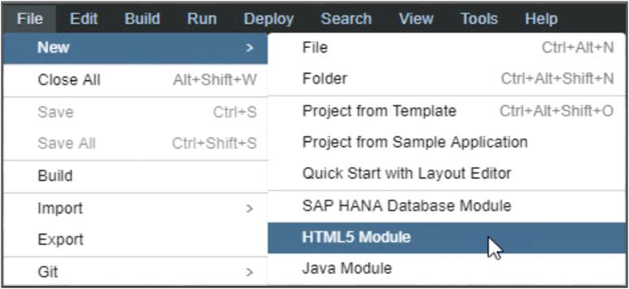
Deploying the App to Cloud Foundry
Create an HTML5 module – UI
Create
Develop
Build & Test
Deploy
Create a new HTML5 module in an MTA project/ business application project
Choose one of the available templates for an HTML5 application
A folder for your module is created in the project and skeleton files are generated
The mta.yaml is updated with the module default
parameters
11

Slide 58
Deploying the App to Cloud Foundry
Further Reading
i
Additional Material
SAP Web IDE Home Page:
https://www.sap.com/developer/topics/sap-webide.html
Technical Questions – Use SAP Community: https://answers.sap.com/tags/73554900100700001351
SAP Cloud Platform:
https://cloudplatform.sap.com/index.html
SAP Cloud Platform Trial:
https://account.hanatrial.ondemand.com/
SAP Help Portal for Deployment to Cloud Foundry: https://help.sap.com/viewer/65de2977205c403bbc 107264b8eccf4b/Cloud/en-US/c4f0d850b6ba46089a 76d53ab805c9e6.html
12

Slide 59
Deploying the App to Cloud Foundry
What you’ve learned in this unit
How to build applications in SAP Web IDE
How to develop SAPUI5 apps in the cloud
How to deploy your first SAPUI5 app to Cloud
Foundry
Guidelines and best practices to develop SAP Fiori apps in the cloud
13

Slide 60
Thank you.
Contact information:
open@sap.com

Slide 61

Follow all of SAP
www.sap.com/contactsap
© 2019 SAP SE or an SAP affiliate company. All rights reserved.
No part of this publication may be reproduced or transmitted in any form or for any purpose without the express permission of SAP SE or an SAP affiliate company.
The information contained herein may be changed without prior notice. Some software products marketed by SAP SE and its distributors contain proprietary software components of other software vendors. National product specifications may vary.
These materials are provided by SAP SE or an SAP affiliate company for informational purposes only, without representation or warranty of any kind, and SAP or its affiliated companies shall not be liable for errors or omissions with respect to the materials. The only warranties for SAP or SAP affiliate company products and services are those that are set forth in the express warranty statements accompanying such products and services, if any. Nothing herein should be construed as constituting an additional warranty.
In particular, SAP SE or its affiliated companies have no obligation to pursue any course of business outlined in this document or any related presentation, or to develop or release any functionality mentioned therein. This document, or any related presentation, and SAP SE’s or its affiliated companies’ strategy and possible future developments, products, and/or platforms, directions, and functionality are all subject to change and may be changed by SAP SE or its affiliated companies at any time for any reason without notice. The information in this document is not a commitment, promise, or legal obligation to deliver any material, code, or functionality. All forward-looking statements are subject to various risks and uncertainties that could cause actual results to differ materially from expectations. Readers are cautioned not to place undue reliance on these forward-looking statements, and they should not be relied upon in making purchasing decisions.
SAP and other SAP products and services mentioned herein as well as their respective logos are trademarks or registered trademarks of SAP SE (or an SAP affiliate company) in Germany and other countries. All other product and service names mentioned are the trademarks of their respective companies.
See www.sap.com/corporate-en/legal/copyright/index.epx for additional trademark information and notices.

